Slide 1

Week 10 Applications and Implications of Internet of Things (Part II)
MM1031 Introduction to Innovation and Entrepreneurship
Dr. Edmond Yeung
Department of Management and Marketing

Slide 2
Agenda
Video: Benefits and Risks of IoT
Why Reflective writing and how to write a good one
Further resources

Slide 3
Video

Slide 4
Today’s sharing about Reflection
What is Reflection & Reflective Learning? Why we need it?

Slide 5


Reflection in Everyday Life
I forgot to bring my umbrella on my way to PolyU
I burnt my chicken this morning
Description on everyday actions and practices

Slide 6
Reflection in Everyday Life
I have to believe myself, not the weather report later (criticism)
I am a forgetful person (Self-understanding)
Chicken burns easily (Knowledge)
Buses come late on rainy days (experience)
Paying attention and reflect on everyday actions and practices

Slide 7

Reflection in Academic Contexts
The active intellectual monitoring and evaluation of one’s formal learning and professional practices …
Leads to new knowledge and self-understanding

Slide 8



Reflective Learning
Learning
Learning
Learning through reflection
Learning
Reflection
+
Learning
Teacher

Slide 9
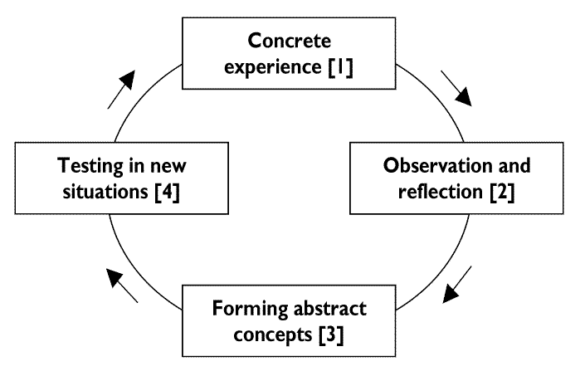
David Kolb’s Experiential Learning Model (ELM)
Experience alone does not necessarily lead to learning;
deliberate reflection on experience is essential

Slide 10
Independent
Autonomous
Self-learner
Learning Intitiative
Motivates students learning
Reflective
Learning
+
Teacher
Students

Slide 11
Impact of Reflective Journals – Literature Review
Students assigned to do reflective journals:
“Helped clarify thoughts”, “more able to work out strategies for solving subject problems”
“Can make use of theoretical knowledge … by reflecting on how it is applicable to real application”
Improved performance on MC, quizzes, etc compared to students who did not …”
General improvement in final reports; students’ description of methods used to solve problems were more complete”
Selfe and Arbabi (1986); Staffan Lundstrom & Shirley Booth (2002); Burrows, McNeill, Hubele & Bellamy (2001)

Slide 12
Other positives outcomes of reflection in engineering education:
Help students’ learning in their course materials
Students become more aware of their strength and limits of their knowledge and understanding
Better communication with students
More confident to participate in discussion in lectures

Slide 13
How can we do Reflection?

Slide 14

Reflective Journals
Many forms of reflective writing:
journals, diary, log, blogs, etc
Non-written forms:
tapes, videos, digital media, etc.
Language:
the one you feel the most comfortable

Slide 15
I tend to make repeating mistakes with this kind of calculations
How could I improve on my learning skills?
I think my interest lies in innovation & entrepreneurship
The theory I learn today seems very relevant to my career development
A student’s intellectual monitoring and evaluation of her formal learning and professional practice

Slide 16
Four “Levels” of Depths in Reflective Writings (Jenny Moon)
Reflective Writing 2
Deep reflection; recognition different frame of reference
Reflective Writing 1
Some analysis; critical; questionings
Descriptive with some Reflection
With points for reflection while not actually reflecting
Descriptive Writing
Descriptive, very little reflection
Notes:
According to Jenny Moon, a teaching and learning and reflective learning expert, there are four level of reflective writing.
The basic level is descriptive writing. If your student’s writing is at this level, it has very little reflection, which means he/she did not think Deep at all.
The second level is Descriptive with some Reflection, which means a writing with points for reflection while not actually reflecting, i.e. not Deep enough.
The third level is Reflective Writing 1, which means a writing with some analysis, critical and questionings, i.e. quite good.
The highest level is Reflective Writing 2, which means a writing with deep reflection, and recognition of different frame of reference, i.e. from different angles. This level is the excellent.

Slide 17
Exercise: Assessing Reflection
3-4 people in a group.
Rank the Students’ Reflection samples (next 3 slides) in order of Good, Average, Bad.
Explain the reason of the ranking.
Suggest 3 ways to become more “reflective”.
Discussion Time: 5 minutes.
Notes:
Let’s do an exercise on Assessing Students’ Reflection….
Any questions? Lets start the discussion.

Slide 18
Student A
Describe your contribution to the project and what you have learnt in the project.
I am responsible for “Field trip and AutoCAD design”. My main contribution is about the decision of route and also the bridge design. I learnt a lot.
Reflect/explain how the experience of participating in this project has helped you to gain a better understanding of what you want to do as an engineer.
This project helps me a lot.

Slide 19
Student B
Describe your contribution to the project and what you have learnt in the project.
I have done the “Environmental impact assessment” part. I learnt a lot in this aspect.
Reflect/explain how the experience of participating in this project has helped you to gain a better understanding of what you want to do as an engineer.
It is quite difficult for me to do the part, as it requires me [to] understand many chapter[s] of the Environmental impact assessment.

Slide 20
Student C
Describe your contribution to the project and what you have learnt in the project.
In the project I have done a particular aspect of job which is related to traffic and structure. This course let me know about how a civil engineer works in a team. Also, I learnt how to prepare a project and give my own idea to others.
Reflect/explain how the experience of participating in this project has helped you to gain a better understanding of what you want to do as an engineer.
I realised that communication and teamwork are very important components of a successful engineer. It is because he or she has to deal with teammates who may have different backgrounds and working styles.

Slide 21
Takeaways
Benefits of IoT:
Boosting productivity
Improving operational efficiency
Creating new business model
Enhancing customer experience
Expanding revenue stream

Slide 22
Takeaways
Risk of IoT:
Complexity
Security
Privacy
Data ethics

Slide 23
Takeaways
Reflective learning is important because it helps you to
Learn deeper
Communicate better
Perform better in academic, practice and career planning
Become an independent learner

Slide 24
Takeaways
To do a good reflection, you have to…
Record your learning seriously and clearly
Evaluate you have achieved
Think of rooms for improvement
Do it honestly and regularly

Slide 25
Takeaways
Advice to your Personal reflection assignment:
Start doing it this week
Finish 1st draft quicky
Review and rewrite it coming weeks for a few times

Slide 26
Enjoy your Reflection Have a nice Week!

